Slide 1
SIYA
The Virtual assistant
&
Desktop Partner

Slide 2
SIYA The Virtual assistant &Desktop Partner
By-
Shruti Bharati (06)
Sayali Shinde (49)
Priti Singh (52)
Shreya Tamhnakar (56)
Under the guidance of
Dr. Anita Morey
Department of Information Technology
Usha Mittal Institute of Technology
2022-2023

Slide 3
Contents
INTRODUCTION
Objective.
Applications
Materails.
The Structure of General Dialogue System.
The actual SIYA Interface.
Code Explanation
Key-points.
Result.
Conclusion & Refrences.
Future Scope

Slide 4
Introduction
One of the goals of Artificial intelligence (AI) is the realization of natural dialogue between humans and machines. in recent years, the dialogue systems, also known as interactive conversational systems are the fastest growing area in AI. Many companies have used the dialogue systems technology to establish various kinds of Virtual Personal Assistants(VPAs) based on their applications
Spoken dialogue systems are intelligent agents that are able to help users finish tasks more efficiently via spoken interactions. Also, spoken dialogue systems are being incorporated into various devices such as smart-phones, smart TVs, in car navigating system.
Previously Chatbots are use for general information with some task execution. But there are some loopholes in these system so we have decided to make Chatbot with daily task execution . User just need to speak their task and they got their outcomes in interactive manner.

Slide 5
Objectives
To develop a desktop virtual assistant that utilizes advanced dialogue systems to provide users with natural and efficient communication, resulting in improved user experience and task completion.
To create a new and improved chatbot that is seamlessly integrated with a desktop virtual assistant, providing users with interactive and efficient outcomes for executing daily tasks.
To integrate spoken dialogue systems into a desktop virtual assistant, enabling users to interact with the assistant through voice commands and providing a more natural form of communication.
To explore potential applications for a desktop virtual assistant that utilizes advanced dialogue systems, including but not limited to productivity tools, scheduling, entertainment, and information retrieval.
To improve the accuracy and effectiveness of the chatbot technology used in the desktop virtual assistant through ongoing development and testing.
To ensure the security and privacy of user data collected and stored by the desktop virtual assistant through the implementation of robust security measures and adherence to data protection regulations

Slide 6
Application:
Personal productivity: The virtual assistant could be integrated with productivity tools like calendars, to-do lists, and email clients, to help users manage their tasks and schedule more efficiently.
Customer service: The virtual assistant could be employed in call centers to help customers with their queries and complaints, providing them with a more personalized and efficient service.
Entertainment: The virtual assistant could be used to suggest movies, music, and TV shows based on the user's preferences, providing them with a more personalized and engaging entertainment experience.
Home automation: The virtual assistant could be used to control smart home devices like lights, thermostats, and security systems, making it easier for users to manage their home environment.
Healthcare: The virtual assistant could be used to monitor patients' health and provide them with personalized advice and reminders to take their medication, helping to improve their overall health and well-being.
Education: The virtual assistant could be used as a language tutor, providing personalized feedback and exercises to help students improve their speaking and listening skills.

Slide 7
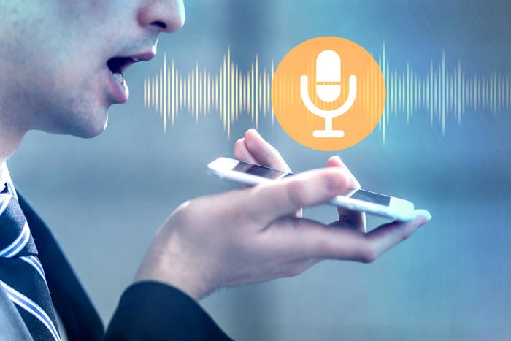

The Structure of General Dialogue System
material
Speech/Voice-based interaction
Speech enables a convenient integration. It is hands-free, eyes-free and keyboard-free. As talking is natural for most of us and it does not require us to learn new skills, the learning curve is low. Humans can speak 150 words on average per minute compared with 40 when typing. Speech interaction can be quickly mastered by young generations, old people, disabled people and illiterate people. It can also be applied in occasions and devices where common interactions are challenging such as while driving, without light, or in extremely small wearables. These advantages make speech an increasingly popular media for devices and applications

Slide 8
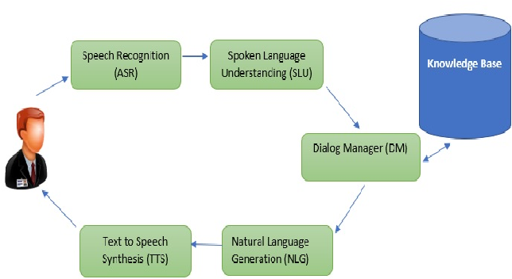
The Structure of General Dialogue System
A dialogue system has mainly seven components: Input Decoder, Natural Language Understanding, Dialogue Manager, Domain Specific Component, Response Generator, and Output Renderer. However, there are six main components in the general dialogue systems, which includes the Speech Recognition (ASR), the Spoken Language Understanding (SLU), Dialog Manager (DM), Natural Language Generation (NLG), Text to Speech Synthesis (TTS), and the knowledge base.

Slide 9
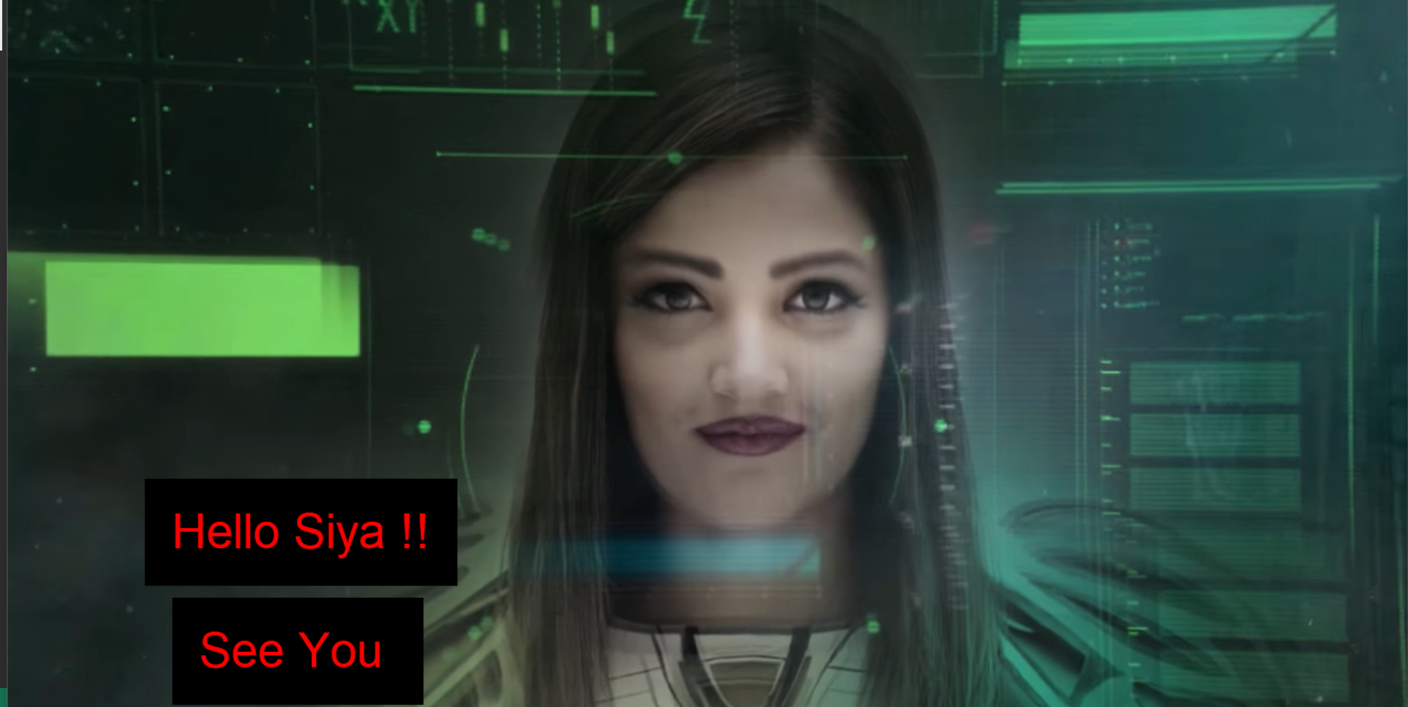
THE ACTUAL SIYA INTERFACE

Slide 10
What is Task Execution?
A task is a unit of execution or unit of work in a software application. Typically, task execution in an embedded processor is managed by the operating system (OS).
Task Execution Life Cycle
The life cycle of a task can be divided into five states:
Created
Waiting
Running
Preempted
Terminated

Slide 11
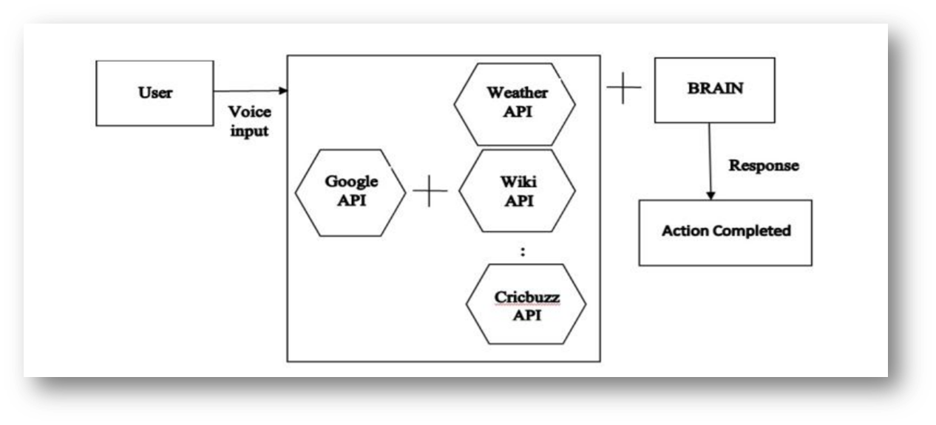
The user gives the input in the form of voice; this voice command is recognized by the application. Then it will check whether it is the authorized user, then action is performed as per the command given by the user. Command given is compared as a form of action and question and respond with the dialog box or search through the knowledge base.

Slide 12
Our Approach:
We propose the Chatbot as a desktop application/Webapp on Android OS. This Desktop Partner provides various functions like general Weather forecasting, Launch Games, Launch Windows Applications, Open Websites, tells you about almost everything you ask, tells you date and time, greetings, news, etc. And also give notification/Reminders about users task on time. Furthermore, we plan to adjust the interface design to be more beautiful and easy to understand.

Slide 13
Code Explanation: (Python Libraries/Modules Used)
Pyttsx3: pyttsx3 is a text-to-speech conversion library in Python.
speech_recognition: Speech recognition is a machine's ability to listen to spoken words and identify them. You can then use speech recognition in Python to convert the spoken words into text, make a query or give a reply.
Datetime: Datetime in Python is the combination between dates and times. The attributes of this class are similar to both date and separate classes.
Wikipedia: The webbrowser module provides a high-level interface to allow displaying web-based documents to users.
OS: Python OS module provides the facility to establish the interaction between the user and the operating system.
Smtplib: Python provides smtplib module, which defines an SMTP client session object that can be used to send mail to any Internet machine with an SMTP or ESMTP listener daemon.

Slide 14
KEY POINTS:
All five services your name, phone number, device location, and IP address; the names and numbers of your contacts.
Our interface gives more secure and privacy atmosphere.
Alexa consume more net and need a strong bandwidth.
Our interface can run with low bandwidth.

Slide 15
What Makes Our Interface Different From Other Assistant.
1)Privacy.
2)More secure,no sharing of data.
3)No adds.
4)Run on low bandwidth.
5) Personal use.

Slide 16
Result:
Get general information when you ask and also get task notification on time.
Now I am sure using our interface introvert guy can easily communicate with its own patner.

Slide 17
Conclusion:
The system enables the user to get features provided by all information + Task Execution on a single platform
This study has found that the work done on Chatbot Assistant has got some limitations. Like when internet is not there or low network area.
It is one of the simple, Entertaining and useful desk application in python
The task execution in this application i.e. Time, entertain and Other events would not let user to miss single tasks in the users routine by allowing user to keep track of everything in social life. It provides single platform to do tasks with ought touching the keyboard and typing.
Now I am sure using our interface introvert guy can easily communicate with its own patner.

Slide 18
Future Scope:
Personalized virtual assistant to handle specific tasks and provide tailored recommendations.
Integration with various devices to provide a seamless experience across multiple platforms.
Improved natural language processing to enhance communication between users and virtual assistants.
Use of machine learning algorithms to improve the accuracy of responses and recommendations.
Integration with other AI technologies such as facial recognition and speech recognition for a more comprehensive experience.
Expanded language support to cater to a wider audience and increase accessibility.
Implementation of emotional intelligence to enable virtual assistants to understand and respond to users' emotions.
Integration with smart home systems to control and manage household appliances and devices.
Use of augmented reality and virtual reality to provide an immersive and interactive experience.
Integration with e-commerce platforms to facilitate online purchases and enhance the shopping experience.

Slide 19
References:
Tkinter 8.5 reference: a GUI for PythonReference documentation for Tkinter 8.5 detailing available classes, methods, and options.
AISHA My Virtual Girlfriend ,Web series.
Chatbot reference :https://www.chatbot.com/
Virtual assistant:https://en.m.wikipedia.org/wiki/Virtual_assistant.
Pyttxs3 Reference :https://www.geeksforgeeks.org/python-text-to-speech-by-using-pyttsx3/.

Slide 20
Thank You

